Slide 1
COST OF LIVING ANALYSIS

Slide 2
OBJECTIVE
To know which country has highest cost of living and which country has lowest cost of living.
To know how the relationship between cost of living and other features.
To check whether there are any patterns in the data.

Slide 3
DATA
Data contains country, city, data quality and other 55 features. Each feature is specific item or product like meal for 2 people, milk 1litre etc and the value is cost of that item in US $.
PREPROCESSING
Data contains too many null values so we replace it with 0.
All the 55 features are in text format so they are changed to float format.
Calculated Cost of living by adding all the values of 55 features.
Categorized the 55 features into 7 categories they are Basic, Luxurious, Transportation, Land, Salary and interest rates, Addiction, Restaurant.

Slide 4
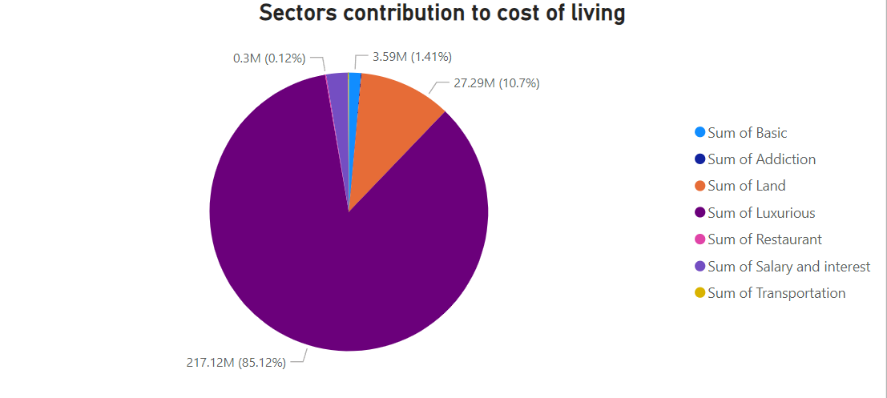
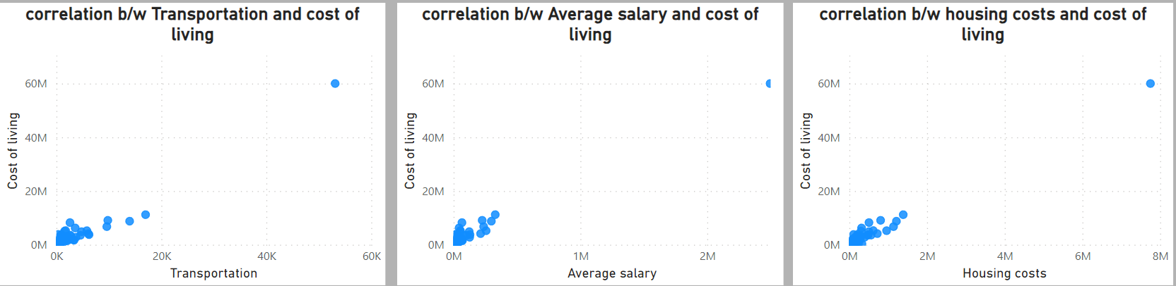
ANALYSIS
From all the sectors Luxurious sector contributing more to the cost of living.
Next highest sector is land with 10.7%.
The least contributing sector to the cost of living is Transportation with 0.08%.
There is a positive correlation between Transportation, Average salary, Land and cost of living.

Slide 5
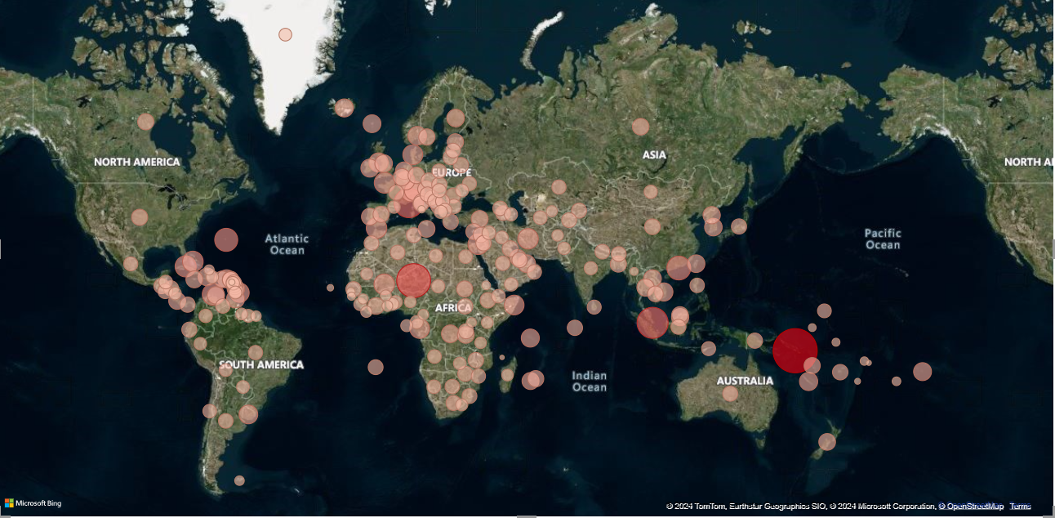
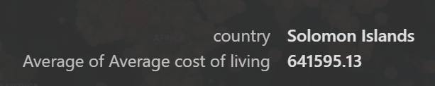
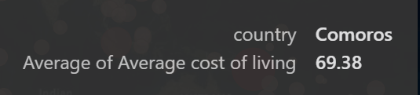
ANALYSIS
Maximum Average cost of living
Maximum Average cost of living
Minimum Average cost of living
Minimum Average cost of living

Slide 6
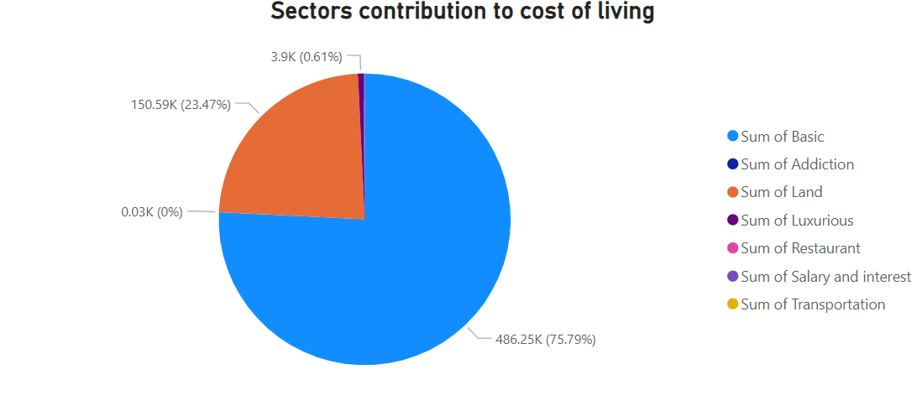
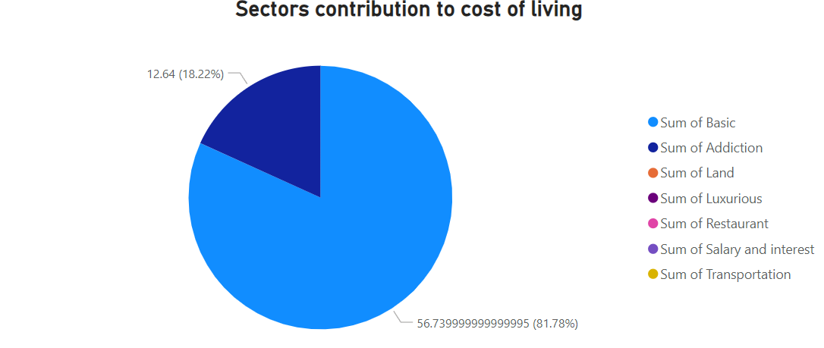
ANALYSIS
In Solomon Islands highest contributor for cost of living is Basic sector with 75.8%.
In Comoros highest contributor for cost of living is Basic sector with 81.78% and the second highest is Addiction sector with 18.22%.

Slide 7
CONCLUSION
Majority of the countries has average cost of living.
Overall the data says luxurious goods contribute more to the cost of living but most of the countries have basic goods as their maximum contributor to the cost of living.
As the cost of living increases people doesn’t show interest to buy luxury goods that is why Solomon Islands has basic sector as major contributor.

